Slide 1
Farm Workers And Racism
Campesinos y Racismo
nfwm.org

Slide 2
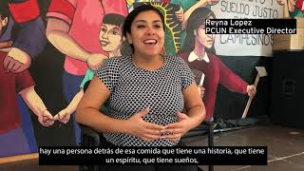
Farm Workers & Racism: The Struggle for Justice, Respect, & Fair Pay
Campesinos y Racismo: La Lucha por la Justicia, el Respeto y el Pago Justo
Notes:
If the video is not playing properly, you can watch it at https://www.youtube.com/watch?v=r4FO7CRl6kY.

Slide 3
Introduction/Introducción
From slavery to sharecropping to exclusions in labor laws, our food system is rooted in racism. Today, our nation's farm workers continue to face challenges and risks connected to this legacy.
Desde la esclavitud hasta la aparcería y las exclusiones en las leyes laborales, nuestro sistema alimenticio tiene sus raíces en el racismo. Hoy en día, los campesinos todavía tienen que enfrentar los desafíos y riesgos relacionados con este legado.
Notes:
Pass out the downloadables Introduction to Farm Workers & Racism or Introducción a los campesinos y el racismo available at https://nfwm.org/resource-center/harvest-of-justice/harvest-of-justice-2023-farm-workers-racism/.

Slide 4
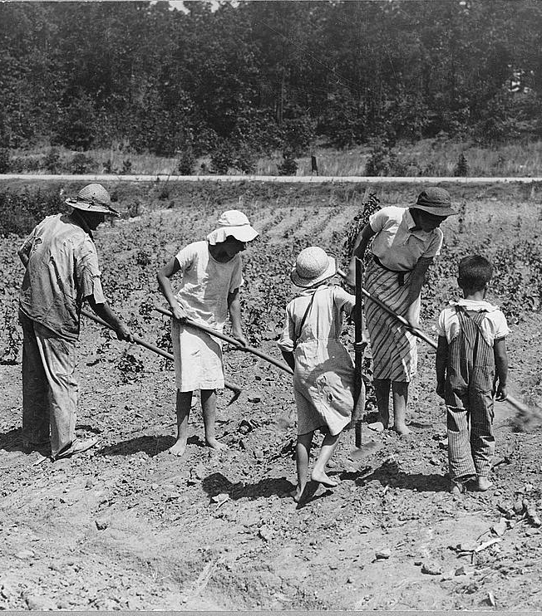
Exclusions from Labor Laws
Exclusiones de las Leyes Laborales
In the mid-1930’s, the US passed several labor laws to protect workers but excluded farm workers and domestic laborers.
In 1935, the NLRA provided the right to organize without retaliation - farm workers and domestic workers were excluded.
A mediados de la década de 1930, EE. UU. aprobó varias leyes laborales para proteger a los trabajadores, pero excluyó a los campesinos y trabajadores domésticos.
En 1935, la NLRA otorgó el derecho a organizarse sin represalias: se excluyó a los campesinos y trabajadores domésticos.
Notes:
FLSA, originally enacted in 1938, guarantees most workers a minimum wage for each hour worked. FLSA also provides for overtime pay by requiring that most employees who work more than 40 hours in a workweek be paid one and one-half times the regular rate of pay for each hour over forty hours per week. FLSA further requires employers to comply with recordkeeping requirements, including maintaining payroll records for employees
Until 1966, the FLSA excluded farmworkers. FLSA now applies the minimum wage and recordkeeping provisions to most agricultural workers and employers. Agricultural workers who are paid on a piecework basis rather than an hourly basis are entitled to receive the minimum wage — their average earnings should be sufficient to yield an average hourly wage at least equivalent to the minimum wage. The overtime pay provisions of FLSA, however, are still not applicable to farmworkers. Further, the many agricultural workers employed on smaller farms — any farm that employs fewer than roughly seven workers in a calendar quarter — are not even protected by the minimum wage provisions of the FLSA. Farmworker Justice, source
Some states have enacted these overtime laws but they are hard to enforce, even on a state level and there is a tremendous amount of pushback from employers. One significant way that employers have sought to get around paying overtime is to only allow 40 hours of work each week and to try to hire additional workers. What it means for farm workers is that they used to consistently work overtime but got no additional pay. Receiving overtime pay now would really help them a lot. Working only 40 hours now means they actually, over the entire harvest, receive less pay for the season.

Slide 5
Excluded on Purpose
Excluido a Propósito
In the past and today, farm workers are predominately people of color. They were and are excluded because of racism.
One legislator from Florida argued in 1937 for the exclusion of farm workers from the FLSA stating on record, "You cannot put the Negro and the white man on the same basis and get away with it."
En el pasado y en la actualidad, los campesinos son en su mayoría personas de color. Fueron y son excluidos a causa del racismo.
En 1937, un legislador de Florida defendió la exclusión de los campesinos declarando públicamente que ¨No se puede poner al negro y al blanco en la misma base y salirse con la suya.¨

Slide 6
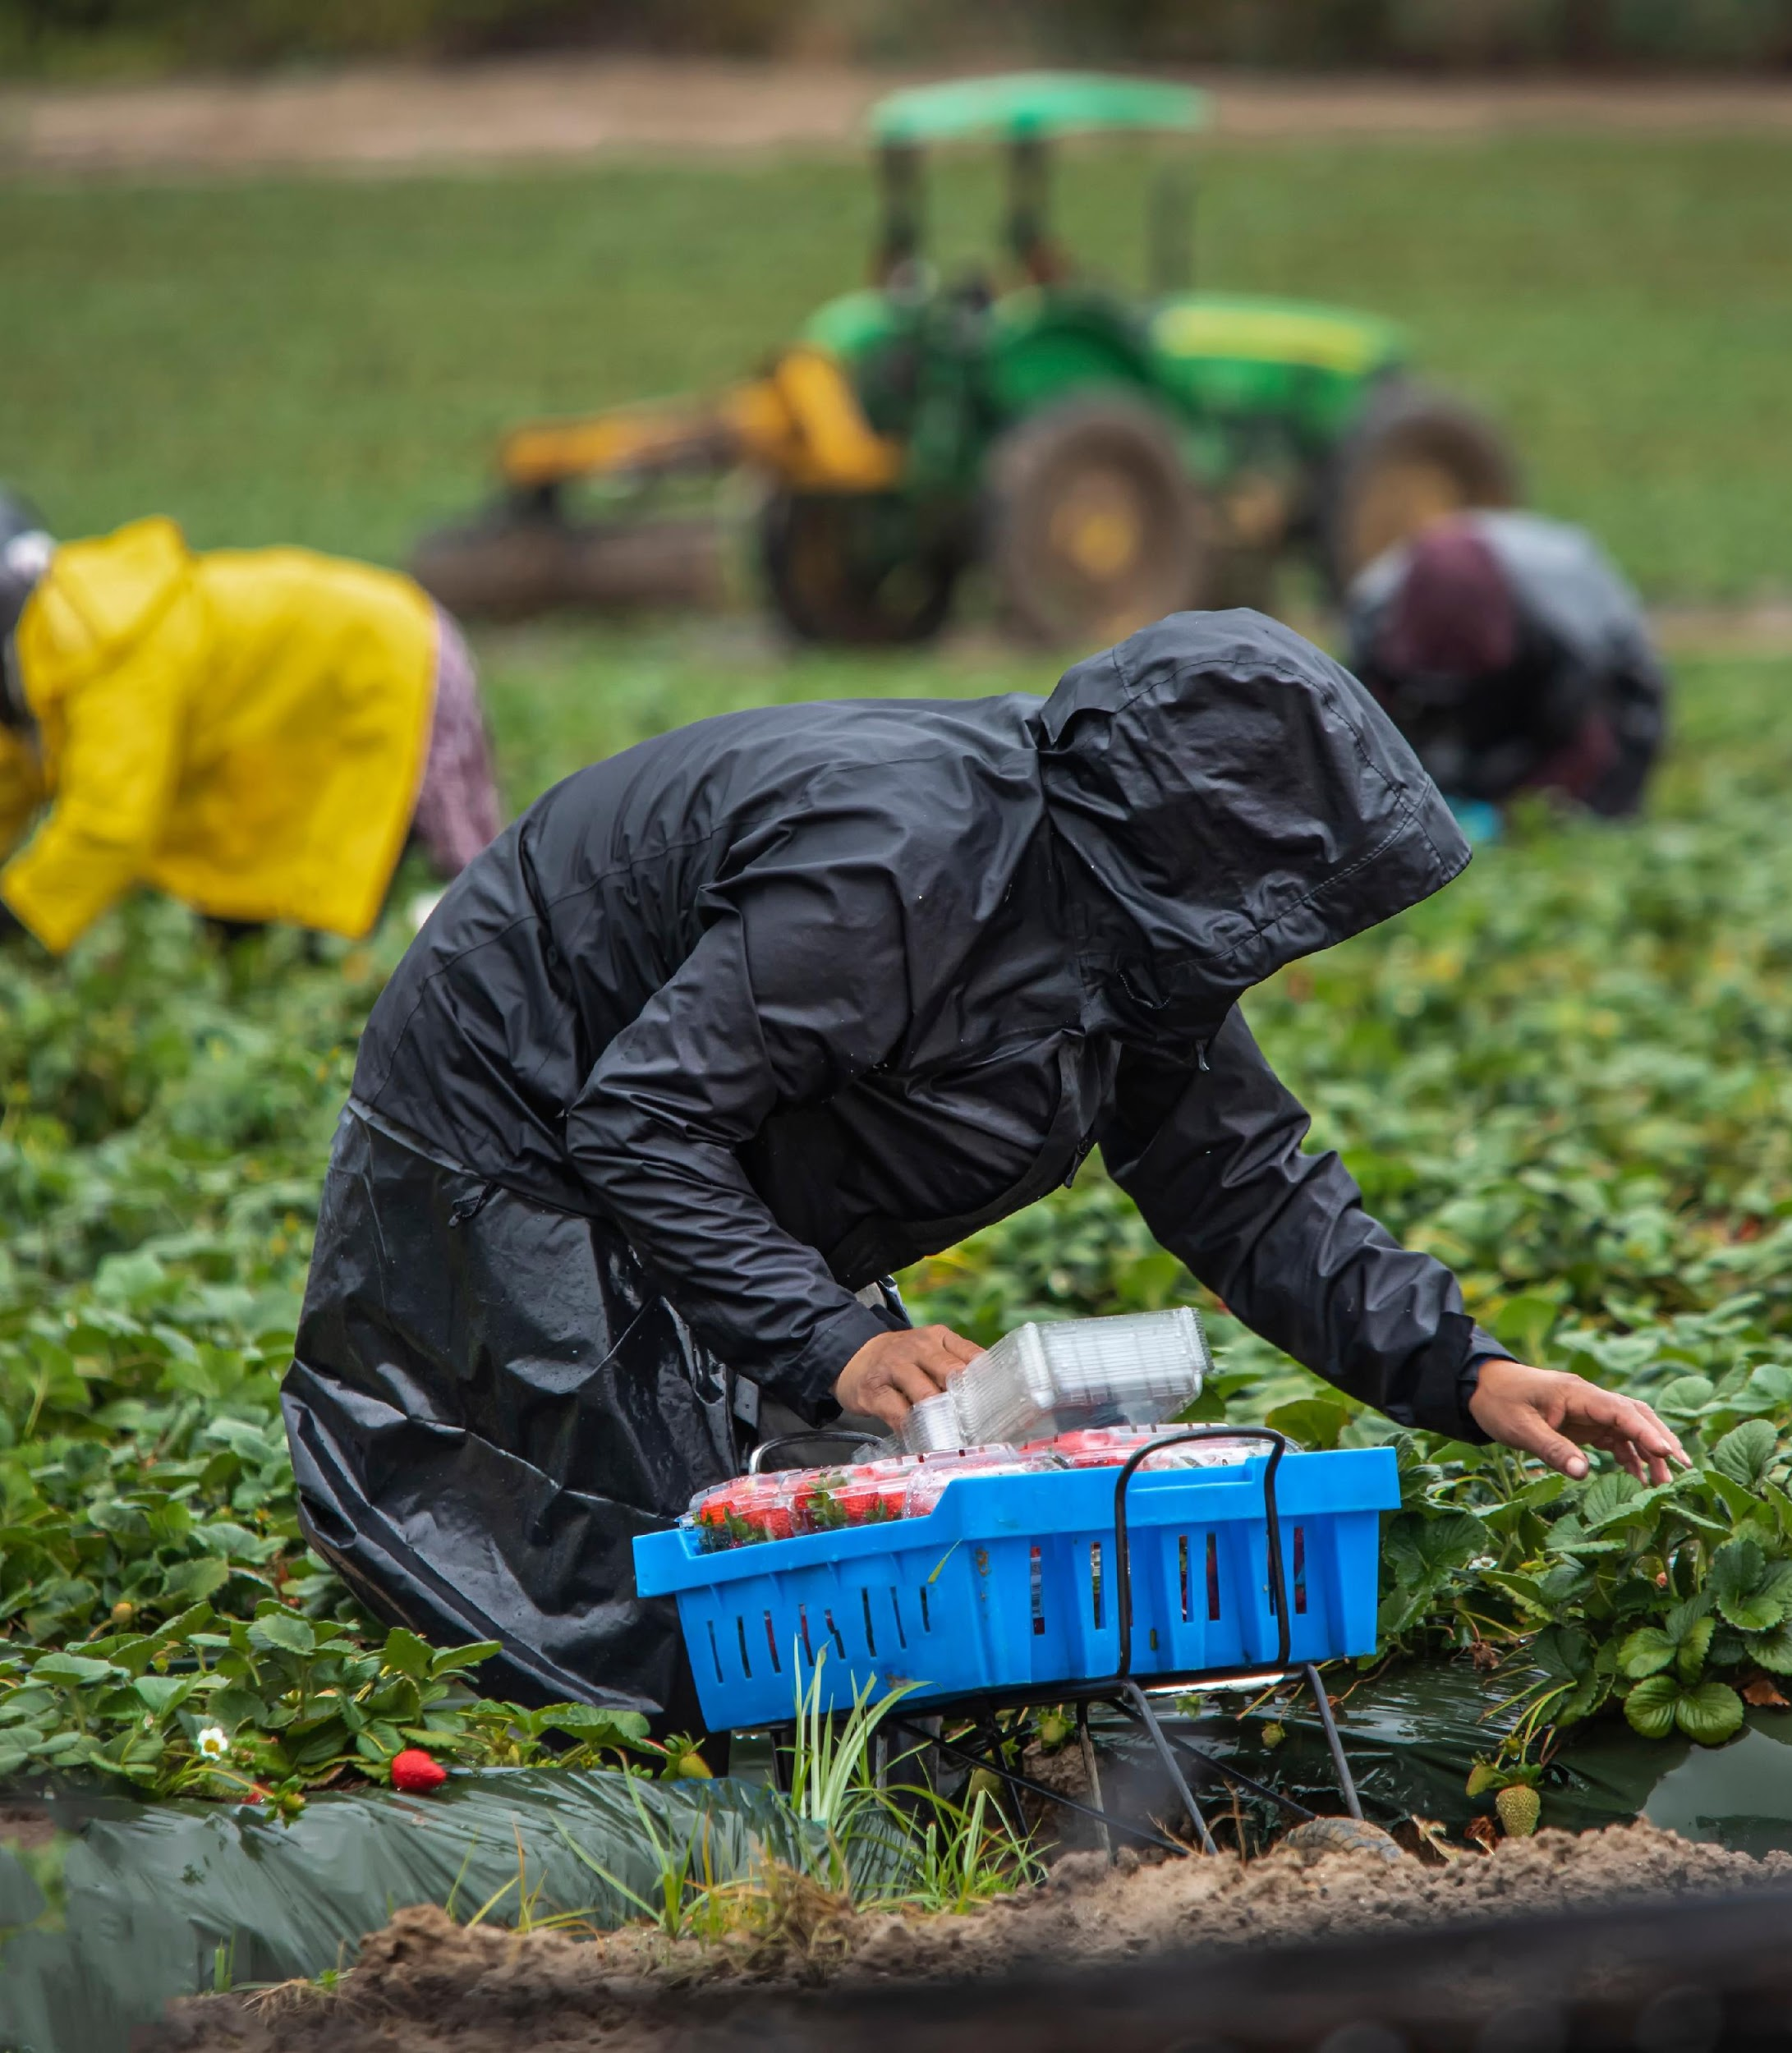
Environmental Racism
Racismo Ambiental
Environmental racism is the disproportionate impact of environmental hazards on people of color.
From temperature changes to natural disasters to environmental hazards, farm workers are on the front lines of climate change.
El racismo ambiental es el impacto desproporcionado de los riesgos ambientales a las personas de color.
Desde los cambios de temperatura hasta los desastres naturales al peligro ambiental, los campesinos están en la primera línea del cambio climático.
Notes:
"The phrase environmental racism was coined by civil rights leader Dr. Benjamin F. Chavis Jr. He defined it as the intentional siting of polluting and waste facilities in communities primarily populated by African Americans, Latines, Indigenous People, Asian Americans and Pacific Islanders, migrant farmworkers, and low-income workers. Study after study has since shown that those communities are disproportionately exposed to fumes, toxic dust, ash, soot, and other pollutants from such hazardous facilities located in their midst. As a result, they face increased risks of health problems like cancer and respiratory issues." https://www.nrdc.org/stories/what-environmental-racism#:~:text=He%20defined%20it%20as%20the,%2C%20and%20low%2Dincome%20workers.
On average, people of color make up 56% of the population living in neighborhoods with Toxic Release Inventory facilities, compared to 30% elsewhere.
A 2018 study by Environmental Protection Agency scientists found that people of color on average faced a 28% higher health burden compared to the general population thanks to living in proximity to facilities emitting particulate pollution like soot. For Black individuals and families, the findings were especially troubling, with a 54% greater health burden reported.
According to a Yale study, Hispanics had the highest exposure rate to 14 different air pollutants.
Communities living below the poverty line have a 35% higher burden from particulate matter emissions (Sierra Club).
According to Coming Clean Inc, Black people were 75% more likely to live near chemical facilities in 2014.
Racial and ethnic minorities in Houston, Chicago, and Baltimore are disproportionately affected by flooding (NAS)
Native American, Alaska Native, and Black individuals are 5 times more likely and Latino 4 times more likely to be hospitalized for COVID-19 than non-Hispanic white people (CDC).
Water contamination greatly impacts children of color who live in rural areas, indigenous communities, and migrant farmworker communities (NRDC).

Slide 7
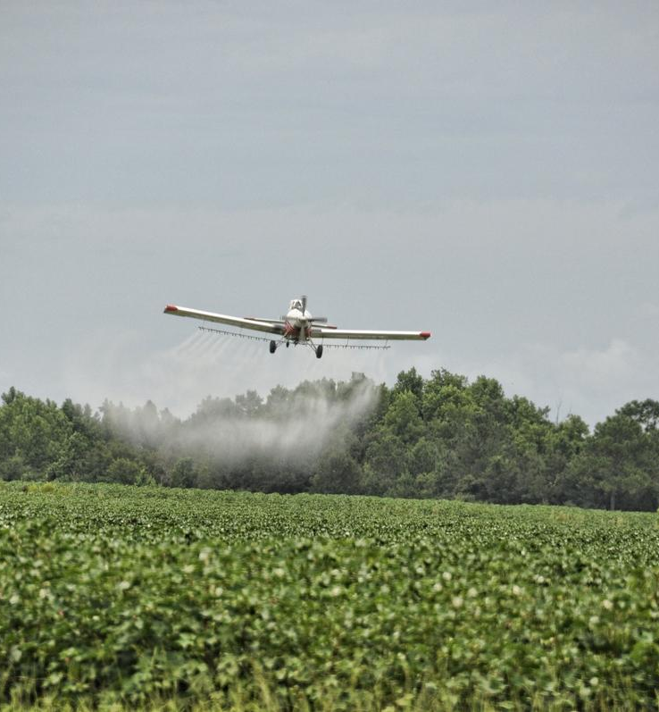
Toxic Pesticides
Pesticidas Tóxicos
Farm workers are also at a disproportionate risk from exposure to pesticides, which can cause short- and long-term illnesses for workers and their families.
Although farm workers are often recognized as an environmental justice community, the U.S. government's regulations and policies offer workers little to no protections against environmental hazards.
Los campesinos y sus familias también corren un riesgo desproporcionado a enfermedades de corto o largo plazo a causa de la exposición a pesticidas.
Aunque los Estados Unidos reconoce a la industria agrícola como una comunidad de justicia ambiental, las regulaciones y políticas del gobierno le ofrecen poca o ninguna protección contra los peligros ambientales.
Notes:
Pesticide exposure is the primary way that farm workers face ongoing and impactful results of environmental racism. Lake Apopka as an example of environmental racism, this story can be found at https://nfwm.org/wp-content/uploads/2023/07/Environmental-Racism-Handout.pdf
Crop spraying can cause direct exposure as can re-entering field prematurely after the fields have been sprayed. “Pesticide drift” can occur for those who live near fields or work near other fields. Pesticide containers may not have labels which are in languages other than English and/or have symbols which are culturally inappropriate. Inadequate training or gear for pesticide applications. Pesticides can also be carried home to families on clothing, shoes and bodies. Children are especially are vulnerable to this.
Chronic and acute health risks are farmers and farm workers exposed to?
Health risks for farmers and farm workers include:
Exposure to farm chemicals, such as pesticides and fertilizers, as well as toxic gases which may be produced from common farm practices like manure decomposition and silo crop storage
Exposure to high levels of dust, which can contain mold, bacteria, and animal droppings, among other things
Falls from ladders, farm equipment, grain bins, or other heights
Exposure to ultraviolet rays from the sun, which can result in skin cancer
Joint and ligament injuries, which can result in arthritic conditions affecting mobility
Exposure to loud noises and sounds from machinery and equipment which can result in hearing loss
Stress from environmental factors, such as droughts, floods, wildfires, pests, and diseases affecting crops and livestock, as well as from working long hours, financial concerns, and feelings of isolation and frustration
Risk of suffocation in a grain bin if a person is engulfed by the grain
Risk of heatstroke, frostbite, or hypothermia from working outside in extreme weather conditions
Risk of injury from operating farm equipment and motorized vehicles
Risk of injury from working with livestock
Risk of electrocution to persons operating large equipment that can contact overhead power lines (Rural Health Information (www.ruralhealthinfo.org)

Slide 8
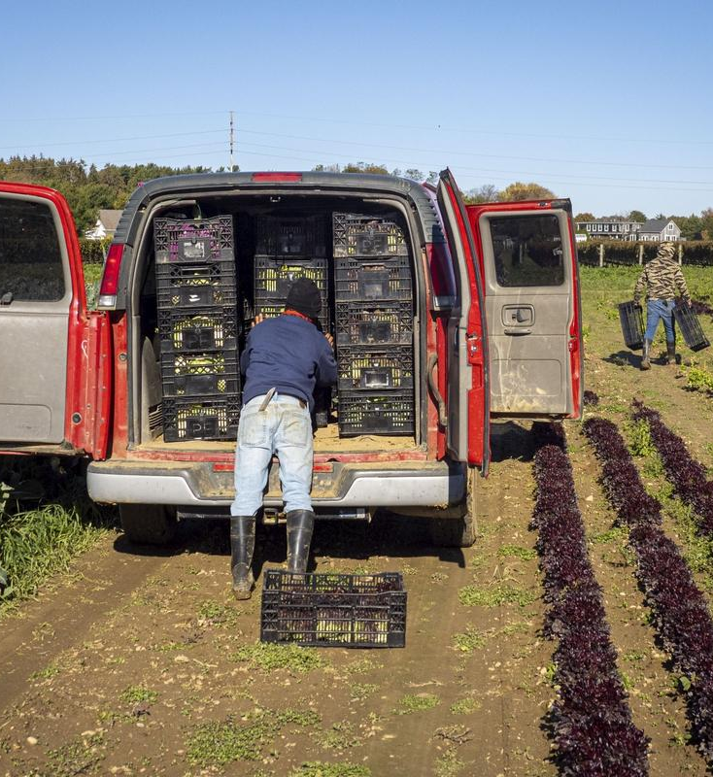
Modern Day Slavery
La Esclavitud Moderna
Due to the migratory and isolated nature of farm work, modern day slavery is all too common in the agricultural sector.
According to the International Labour Organization, migrant workers are more than three times more likely to be in forced labour than non-migrant adult workers.
Debido a la naturaleza migratoria y aislada del trabajo agrícola, la esclavitud moderna es demasiado común en el sector agrícola.
Según la Organización Internacional del Trabajo, los trabajadores migrantes tienen tres veces más probabilidades de sufrir trabajo forzoso que los trabajadores adultos no migrantes.
Notes:
Researchers estimate that 40 million are enslaved worldwide, generating $150 billion each year in illicit profits for traffickers. About 50 percent (21 million) toil in forced labor slavery in industries where manual labor is needed—such as farming, ranching, logging, mining, fishing, and brick making—and in service industries working as dish washers, janitors, gardeners, and maids.
The Global Slavery Index estimates that more than 400,000 are living in modern slavery in the U.S.

Slide 9
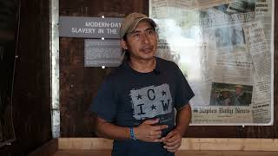
Modern Day Slavery Video
Video de la Esclavitud Moderna
Notes:
If the video is not playing properly, you can also watch it at https://www.youtube.com/watch?v=WJaWHdRbnkQ&t=4s.
One of the most recent cases of modern day slavery include Operation Blooming Onion in Georgia where more than 100 farm workers faced wage theft and physical abuse and were illegally transported; two died due to heat exposure. Employees from Georgia Department of Labor were among the two dozen indicted in this case.
Additional cases can be found at https://foodispower.org/human-labor-slavery/slavery-in-the-us/
Many cases are never reported/discovered due to intimidation, threats, and workers being unaware of how to report abuse.

Slide 10
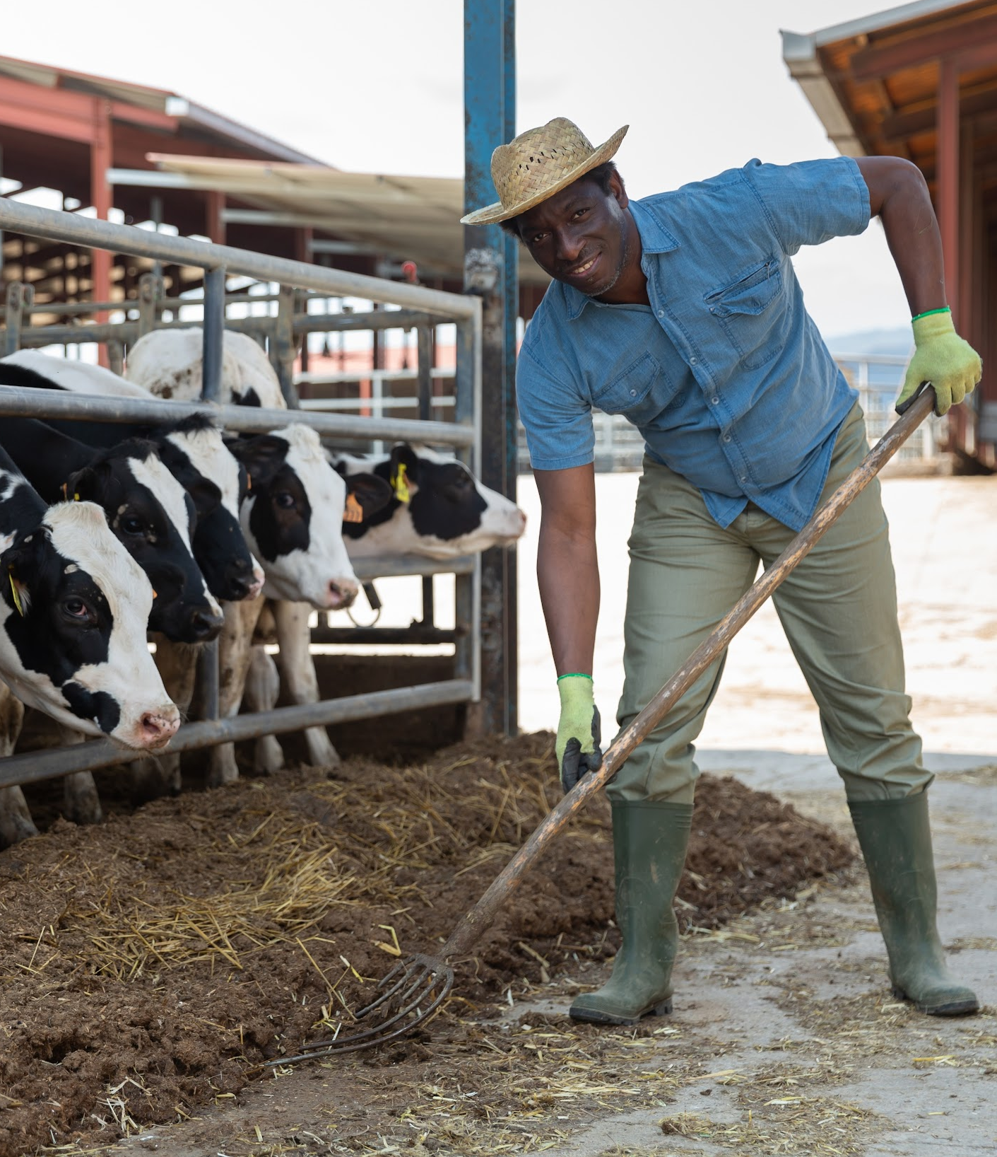
Loss of BIPOC Farmers
Pérdida de Agricultores BIPOC
In 1920, Black farmers made up 14% of all farmers.
BIPOC farmers make up less than 5% of all U.S. farmers.
It is estimated that Black farmers lost around $326 billion worth of land within the 20th century. Much of this loss is due to discriminatory practices.
En 1920, los agricultores negros constituían el 14% de todos los agricultores.
Los agricultores de BIPOC ahora representan menos del 5% de todos los agricultores en los EE. UU.
Se estima que los agricultores negros perdieron alrededor de $ 326 mil millones en tierras en el siglo XX. Gran parte de esta pérdida se debe a prácticas discriminatorias.
Notes:
Black, Indigenous, People Of Color (BIPOC)
These statistics in no way represent native peoples who were first on this land as farmers.

Slide 11
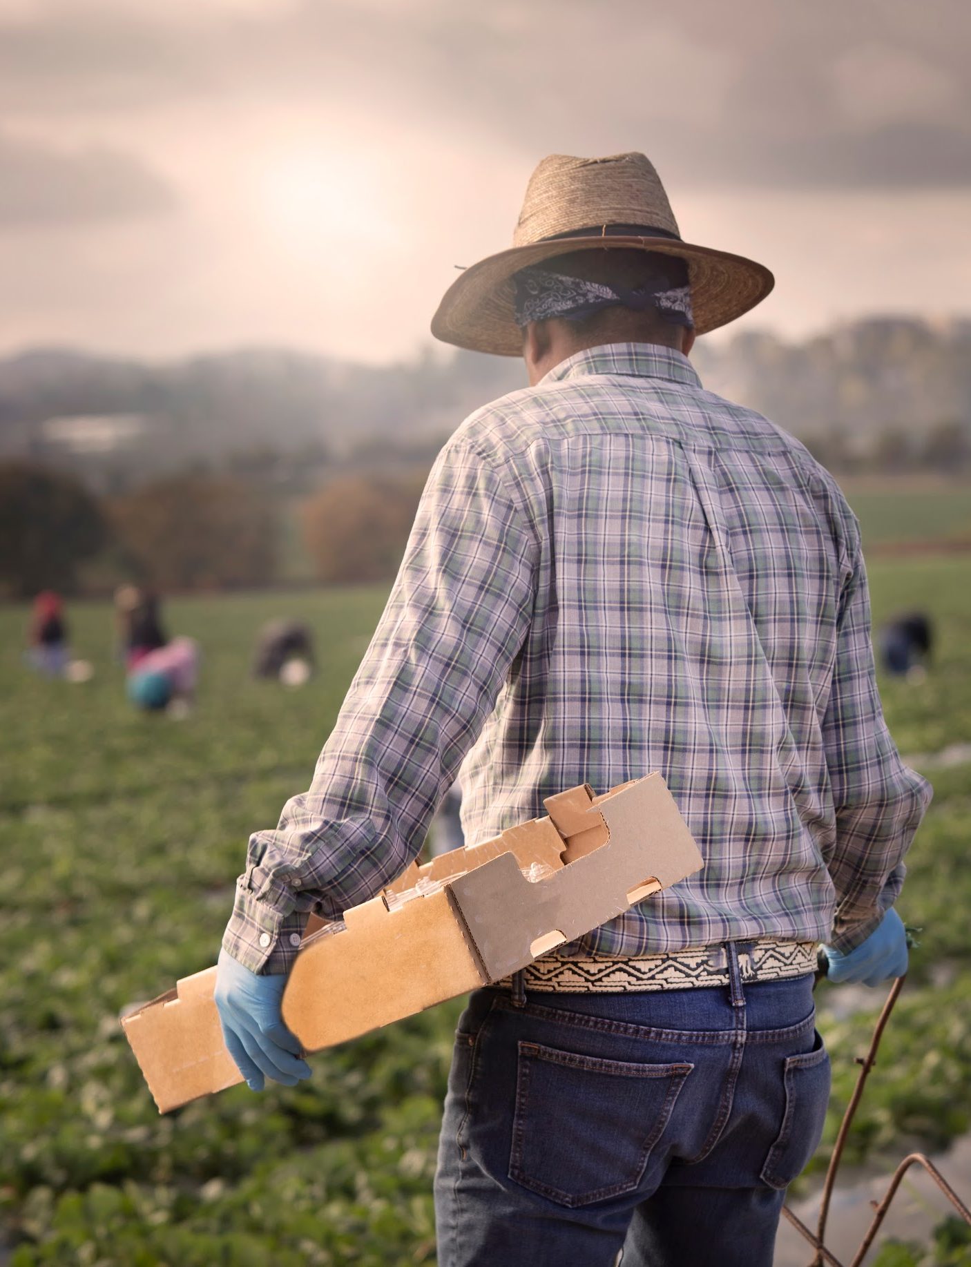
Farm Workers Lead the Way
Los Campesinos Lideran el Camino
Farm workers around the country are organizing and leading campaigns to change their inhumane working and living conditions.
Farm worker campaigns include creating consumer pressure on companies, boycotting, calling on elected politicians, and/or supporting certification programs. Campaigns may be local, regional, national and even global.
Los campesinos de todo el país se están organizando y liderando campañas para cambiar sus condiciones inhumanas de trabajo y de vida.
Las campañas de los campesinos incluyen crear presión de los consumidores sobre las empresas, boicotear, llamar a los políticos electos y/o apoyar los programas de certificación. Las campañas pueden ser locales, regionales, nacionales e incluso globales.
Notes:
Be sure to note that farm workers are organizing themselves into unions to give them the same voice in their workplace that other workers have.

Slide 12
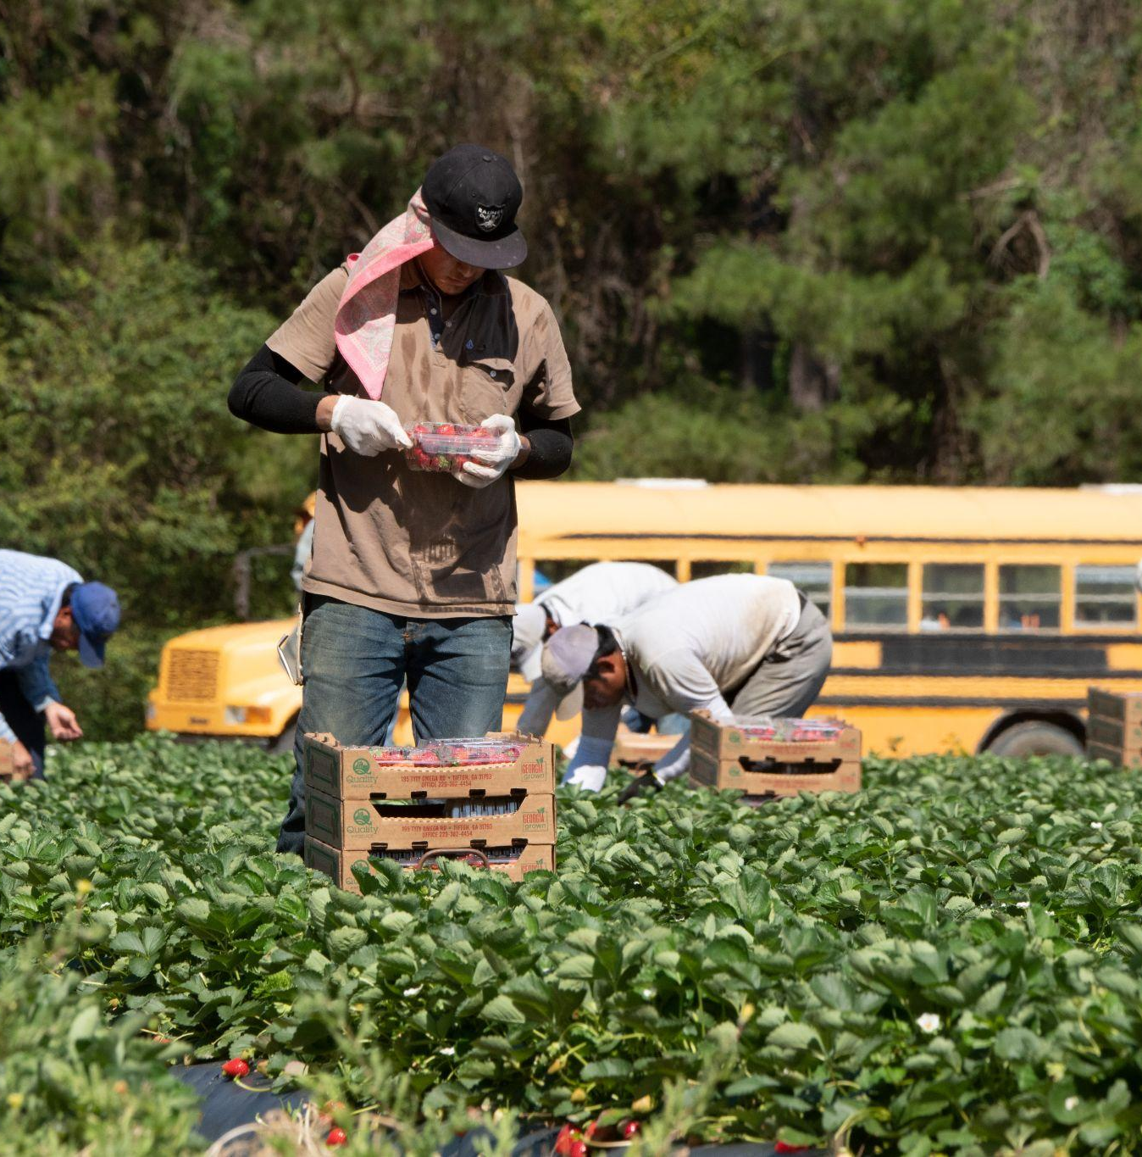
Take Action – Toma Acción
Federal Legislation:
Ban Organophosphates
Fairness for Farm Workers
Asuncion Valdivia Heat Illness Act
Justice for Black Farmers Act
Increasing Land Access, Security, and Opportunities Act
Legislación Federal:
Prohibición de organofosforados
Equidad para los trabajadores agrícolas
Asuncion Valdivia
Justicia para los Agricultores Negros
Aumento del Acceso a la Tierra, la Seguridad y las Oportunidades
Notes:
Utilize NFWM’s campaign pages to assist with specifics about these legislative efforts.
Here are the specific names and numbers for each legislation:
H.R.4897 - Asunción Valdivia Heat Illness, Injury, and Fatality Prevention Act of 2023
S.2501 - Asunción Valdivia Heat Illness, Injury, and Fatality Prevention Act of 2023
S.2253 - Fairness for Farm Workers Act
H.R.4579 - Fairness for Farm Workers Act
S.96 - Justice for Black Farmers Act of 2023
H.R.1167 - Justice for Black Farmers Act of 2023
S.2340 - Increasing Land Access, Security, and Opportunities Act
H.R.3955 - Increasing Land Access, Security, and Opportunities Act

Slide 13
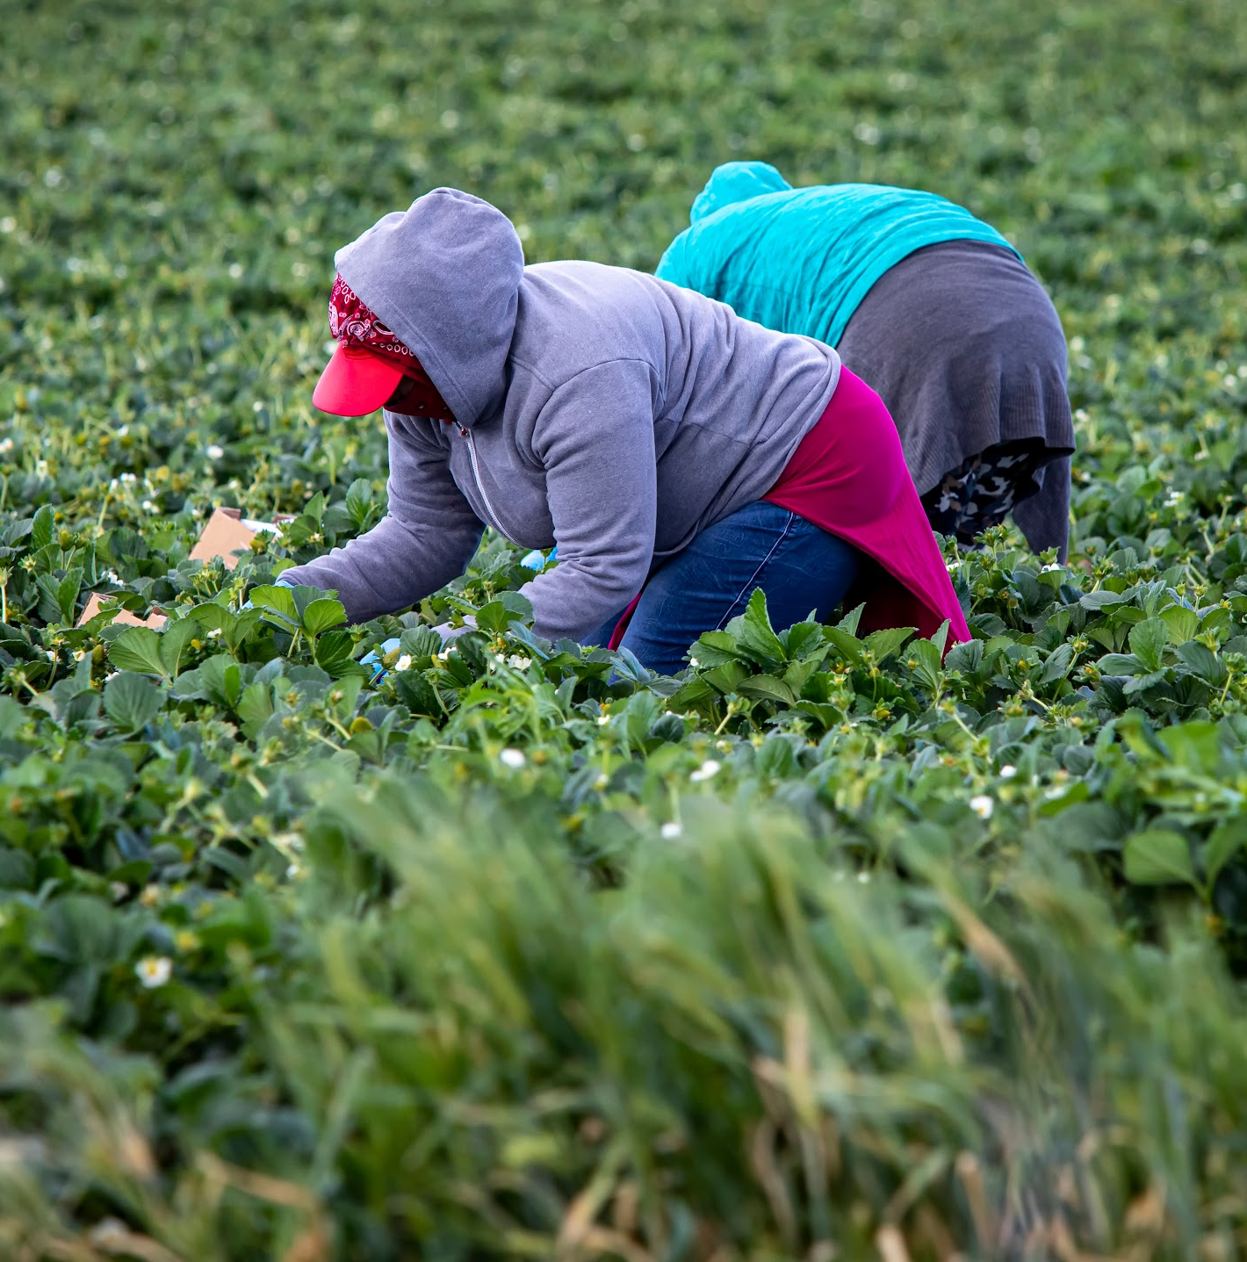
Take Action – Toma Acción
Other
Support Farm Worker Campaigns
Boycott Wendy’s
Use NFWM’s resources to educate your community about issues affecting farm workers
Otra
Apoye las campañas de campesinos
Boicot a Wendy's
Utilice los recursos de NFWM para educar a su comunidad sobre los problemas que afectan a los campesinos
Notes:
More about these are included on our website under TAKE ACTION and RESOURCE CENTER.

Slide 14
THANK YOU! – ¡GRACIAS!
Connect with NFWM:
Conéctese con NFWM:
@nfwministry
Sign-up for our news at:
nfwm.org/contact
nfwm.org

